Slide 1
Software Requirement Engineering
By
Engr. Zahid Hussain Khaskheli
Assistant Professor Software Engineering MUET Jamshoro.

Slide 2
Disclaimer
The material used in this presentation i.e., pictures/graphs/text, etc. is solely intended for educational/teaching purpose, offered free of cost to the students for use under special circumstances of Online Education due to COVID-19 Lockdown situation and may include copyrighted material - the use of which may not have been specifically authorized by Copyright Owners.
It’s application constitutes Fair Use of any such copyrighted material as provided in globally accepted law of many countries.
The contents of presentations are intended only for the attendees of the class being conducted by the presenter.

Slide 3
Requirement engineering
Requirement engineering is consists of two basic concepts :
Understanding customers needs.
Documenting customers needs.
Customers needs : functionalities needed by customers from the software to be developed- customers expectations- features

Slide 4
Requirement
Requirement is the feature of the system or description of something the system is capable of doing in order to fulfill system’s purpose.
Whenever we define requirements we define WHAT of the System not HOW.
What to do? Not How to do it?
What features or requirement needs to be fulfilled not How features are implemented .
Therefore Requirement engineering tell WHAT of the system not How system is to be implemented or developed.
Notes:
Example : REQ. System should e capable to register a customer.

Slide 5
SOFTWARE REQUIEMENTS ENGINEERING
Requirements- Requirements is the phase where the “what “of the software system is defined.
It involves extensive user participation and ends with an approved set of requirements documented in a software requirements specifications (SRS) document.
These software requirements specifications (SRS) form the basis of all further work in the project.
Notes:
Engineering : use of scientific principles to design and build--------

Slide 6
IEEE standard 610.12-1990 define requirements in the context of a software project as follows:
A condition or capability needed by a user to solve a problem or achieve an objective.
A condition or capability that must be met or possessed by a system or system component to satisfy a contract, standard, specification or other formally imposed documents.

Slide 7
Characteristics Of Requirements
Requirements must be validated
Are the requirements correct?
Are the requirements consistent?
Are the requirements complete?
Are the requirements realistic?
Does each requirement describe something needed by the customer?

Slide 8
Functional requirements which define part of the systems functionality.
Non-functional requirements that put constraints on the system developed:
Notes:
Banking Application Example- Fucntions/Servies , Response Time.

Slide 9
Work product
Software requirement specification(SRS):
Requirement engineering produces one large document written in natural language, containing description of WHAT system will do without describing how it will do it.

Slide 10
Input to RE
Problem statement prepared by the customer.
Overview of the existing system.
New or additional functionality to be added.

Slide 11
Importance
Because with help of SRS customer and developer can easily validate the system to be developed.
Why requirement engineering ?
Because without well written requirements:
Developers will not know what to do
Customers may not be consistent about their requirements
It becomes difficult for the customers to validate or accept the software.

Slide 12
Importance of Software Requirements Engineering in the Early Stages of A Project
Why is it so important?
Like all products, the makers of software are seeking to produce the best product in the most cost-efficient manner.
If software errors are found in the requirements phase, they are much, much less expensive to fix than if they are found in later phases of the development process.
For systems regarding safety, the errors in requirements could potentially be even more harmful than just losing money.

Slide 13
Importance of Software Requirements Engineering in the Early Stages of A Project
This phase is used to translate the imprecise, incomplete needs and wishes of the potential users of software into complete, precise and formal specifications.
The specifications act as the contract between the software users and the developers.
Therefore the importance of Requirement Engineering is enormous to develop effective software and in reducing software errors at the early stage of the development of software.
Notes:
The Requirement Engineering (RE) is the most important phase of the Software Development Life Cycle (SDLC).
Since Requirement Engineering (RE) has great role in different stages of the SDLC, its consideration in software development is crucial.

Slide 14
Requirement Engineering Process
The process to gather the software requirements from client, analyze and document them is known as requirement engineering.
The goal of requirement engineering is to develop and maintain sophisticated and descriptive Software Requirements Specification (SRS) document.

Slide 15
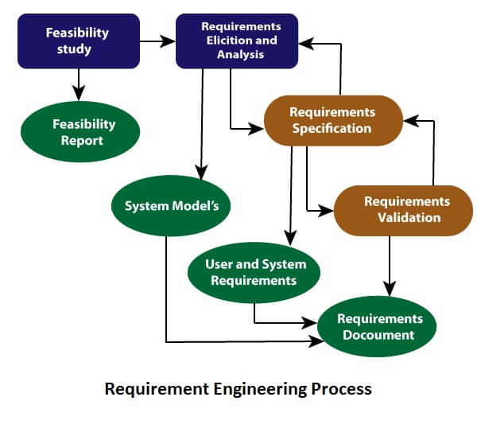
Requirement Engineering Process: Activities/ Steps

Slide 16
Requirement Engineering Process: Activities/ Steps
It is a four step process, which includes –
Feasibility Study
Requirement Elicitation
Software Requirement Specification
Software Requirement Validation

Slide 17
Feasibility study
Why feasibility study?
When the client approaches the organization for getting the desired product to be developed, it comes up with rough idea about what all functions the software must perform and which all features are expected from the software.
Referencing to this information, the Analyst does a detailed study about whether the desired system and its functionality are feasible to develop.
Notes:
Project managers use feasibility studies to discern the pros and cons of undertaking a project before they invest a lot of time and money into it.
Feasibility studies also can provide a company's management with crucial information that could prevent the company from entering blindly into risky businesses.

Slide 18
Feasibility study-Definition
Feasibility study is an analysis that takes all of a project's relevant factors into account:
Economic, technical, legal, and scheduling.
To ascertain the likelihood of completing the project successfully
Notes:
Information such as resource availability, cost estimation for software development, benefits of the software to the organization after it is developed and cost to be incurred on its maintenance are considered during the feasibility study.

Slide 19
Feasibility study-Objectives
Acceptable to users, adaptable to change and conformable to established standards.
Various other objectives of feasibility study are listed below:
• To analyze whether the software will meet organizational requirements-goals.
• To determine whether the software can be implemented using the current technology and within the specified budget and schedule.
• To determine whether the software can be integrated with other existing software.
Notes:
The objective of the feasibility study is to establish the reasons for developing the software that is acceptable to users, adaptable to change and conformable to established standards.

Slide 20
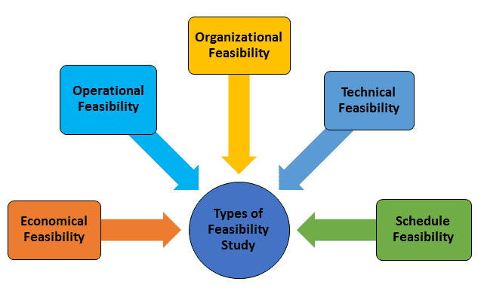
Types of Feasibility
Legal Feasibility

Slide 21
Types-Feasibility study
Technical Feasibility - In Technical Feasibility current resources both hardware software along with required technology are analyzed/assessed to develop project.
This technical feasibility study gives report whether there exists correct required resources and technologies which will be used for project development.
Along with this, feasibility study also analyzes technical skills and capabilities of technical team, existing technology can be used or not, maintenance and up-gradation is easy or not for chosen technology etc.

Slide 22
Types- Feasibility study
Operational Feasibility - In Operational Feasibility degree of providing service to requirements is analyzed along with how much easy product will be to operate and maintenance after deployment.
Notes:
Eg customer wants bulk processing of data/ transactions

Slide 23
Types- Economic Feasibility
In Economic Feasibility study cost and benefit of the project is analyzed.
Under this feasibility study a detail analysis is carried out what will be cost of the project for development which includes all required cost for final development like hardware and software resource required, design and development cost and operational cost and so on.
After that it is analyzed whether project will be beneficial in terms of finance for organization or not.

Slide 24
Types –Feasibility
Legal Feasibility –In Legal Feasibility study project is analyzed in legality point of view.
This includes analyzing barriers of legal implementation of project, data protection acts or social media laws, license, copyright etc.
Overall it can be said that Legal Feasibility Study is study to know if proposed project conform legal and ethical requirements.

Slide 25
Types –Feasibility
Schedule Feasibility –In Schedule Feasibility Study mainly timelines/deadlines are analyzed for proposed project which includes how much time teams will take to complete final project which has a great impact on the organization as purpose of project may fail if it can’t be completed on time.

Slide 26
Requirements elicitation
If the feasibility report is positive towards undertaking the project, next phase starts with gathering requirements from the user.
Requirements gathering
Analysts and engineers communicate with the client and end-users to know their ideas on what the software should provide and which features they want the software to include.
Requirements analysis
Once requirements are gathered, the requirements are checked in detail- such as inconsistency, contradictions, omissions or defects
Notes:
requirements are identified with the help of customers and existing systems processes, if available. Analysis of requirements starts with requirement elicitation.

Slide 27
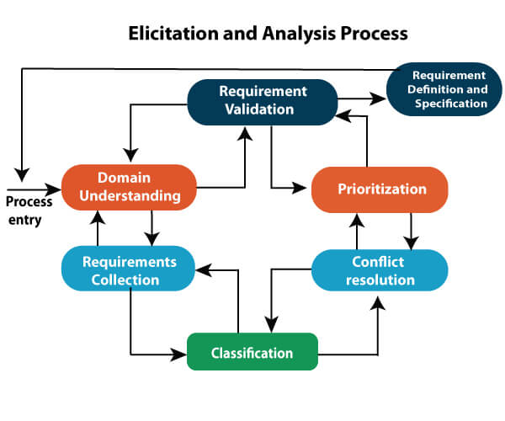

Slide 28
Problems of Elicitation and Analysis
Getting all, and only, the right people involved.
Stakeholders often don't know what they want
Stakeholders express requirements in their terms.
Stakeholders may have conflicting requirements.
Requirement change during the analysis process.

Slide 29
Software requirements specification
SRS is a document created by system analyst after the requirements are collected from various stakeholders (sources).
SRS defines how the intended software will interact with hardware, external interfaces, speed of operation, response time of system, portability of software across various platforms, maintainability, speed of recovery after crashing, Security, Quality, Limitations etc.
The requirements received from client are written in natural language. It is the responsibility of system analyst to document the requirements in technical language so that they can be comprehended and useful by the software development team.
Notes:
the requirement received by the customer written in ordinary language. It is the job of the analyst to write the requirement in technical language so that they can be understood and beneficial by the development team.

Slide 30
Software requirements specification
The models used at this stage include ER diagrams, data flow diagrams (DFDs), function decomposition diagrams (FDDs), data dictionaries, etc.
Data Flow Diagrams: DFD shows the flow of data through a system. The system may be a company, an organization, a set of procedures, a computer hardware system, a software system, or any combination of the preceding.
Notes:
Data Flow Diagrams (DFDs) are widely used for modeling the requirements.

Slide 31
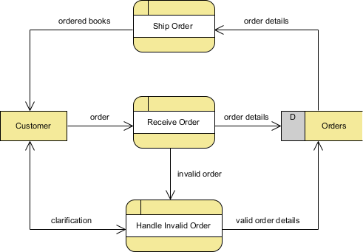
DFD Example-Online Bookstore
Notes:
Key Concepts of Data Flow Diagram-Process(eg. Process order), External Entity(Customer), Data Store(Database tables- inventory), Data Flow(Arrows)

Slide 32
Software requirements specification
Data Dictionaries: Data Dictionaries are simply repositories to store information about all data items defined in DFDs.
After each data object or item is given a descriptive name, its relationship is described.
The type of data, such as text or image or binary value, is described, possible predefined default values are listed and a brief textual description is provided. This data collection can be organized for reference into a book called a data dictionary.

Slide 33
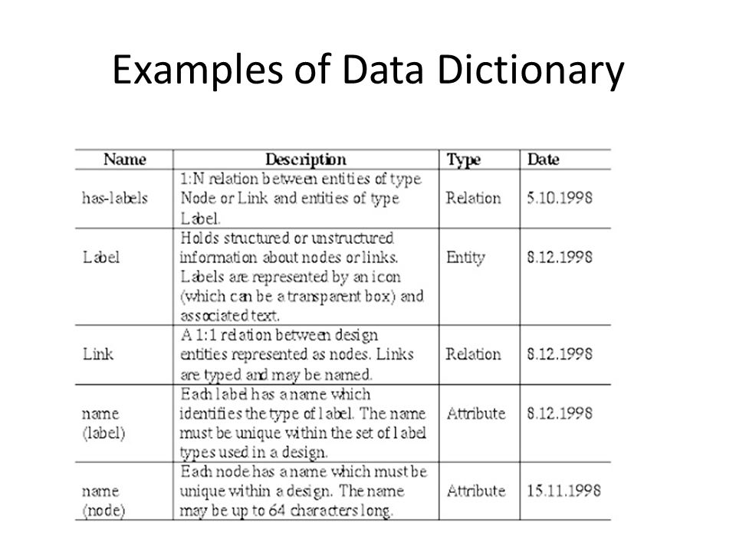

Slide 34
Software requirements specification
Entity-Relationship Diagrams: Another tool for requirement specification is the entity-relationship diagram, often called an "E-R diagram.
It is a detailed logical representation of the data for the organization and uses three main constructs i.e. data entities, relationships, and their associated attributes.

Slide 35
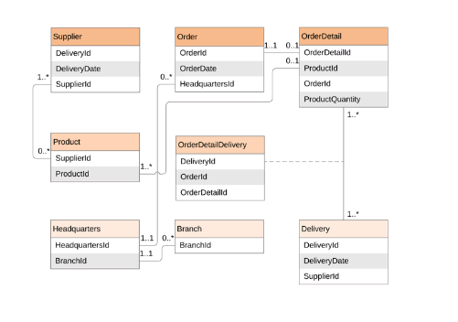
Notes:
Examples :One to One ----Login Form and Student
One to Many-----Student and Teacher
Many to Many ------ Customer and Product

Slide 36
Requirement validation- Review
User might ask for illegal, impractical solution or experts may interpret the requirements incorrectly.
This results in huge increase in cost if not nipped in the bud.
Requirements can be checked against following conditions :
If they can be practically implemented
If they are valid and as per functionality and domain of software.
If there are no any ambiguities
If they are complete
Notes:
After requirement specifications are developed, the requirements mentioned in this document are validated.

